Slide 1
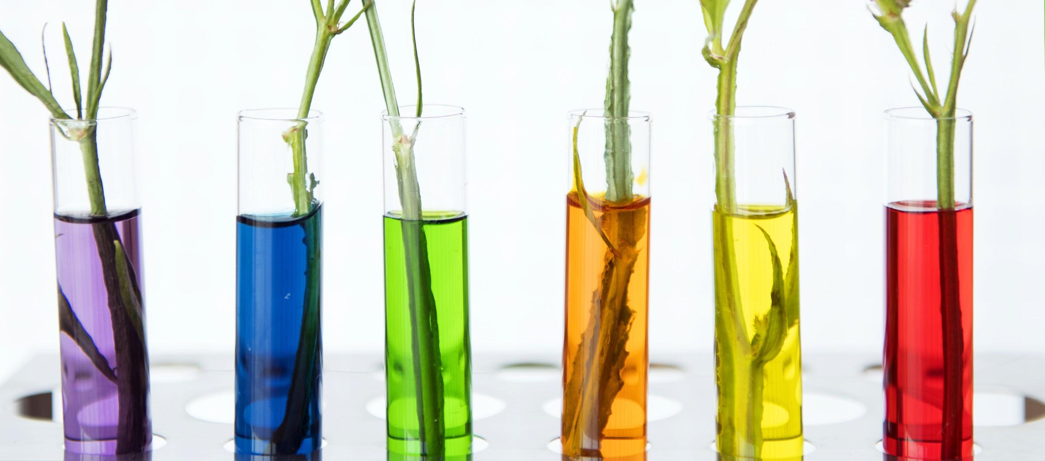
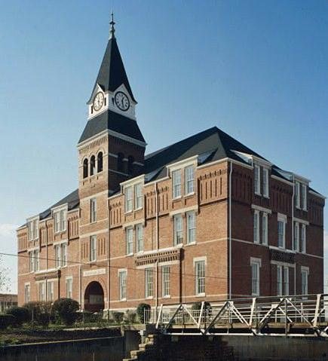
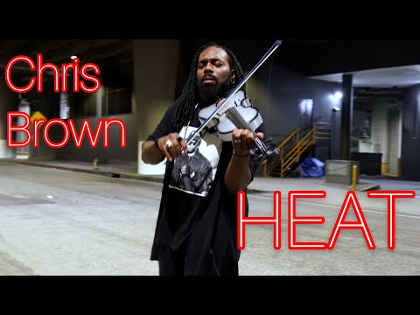
Morris Brown College
STEM SCIENCE
Welcome to Our NEW
INTERACTIVE OUTDOOR LEARNING CENTER
THE DREAM Center
The Paw will take you to the next Slide
Mr. Scott's STREAM Class
Yes, We have
Violin Lessons
Meet Mr. Scott!
Science* Technology* Reading* Engineering* Art/ Agriculture * Math
9th
10th
11th
12th
SUPPORT OUR SCHOOL
Science Fair Projects
Science Standards
A.R. Johnson Health Science & Engineering
Magnet School 6-12

Slide 2
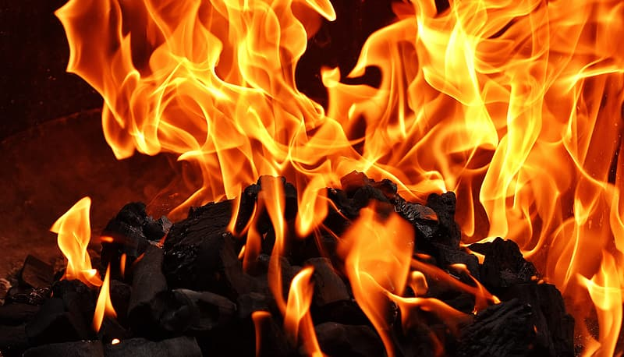
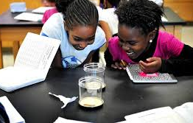
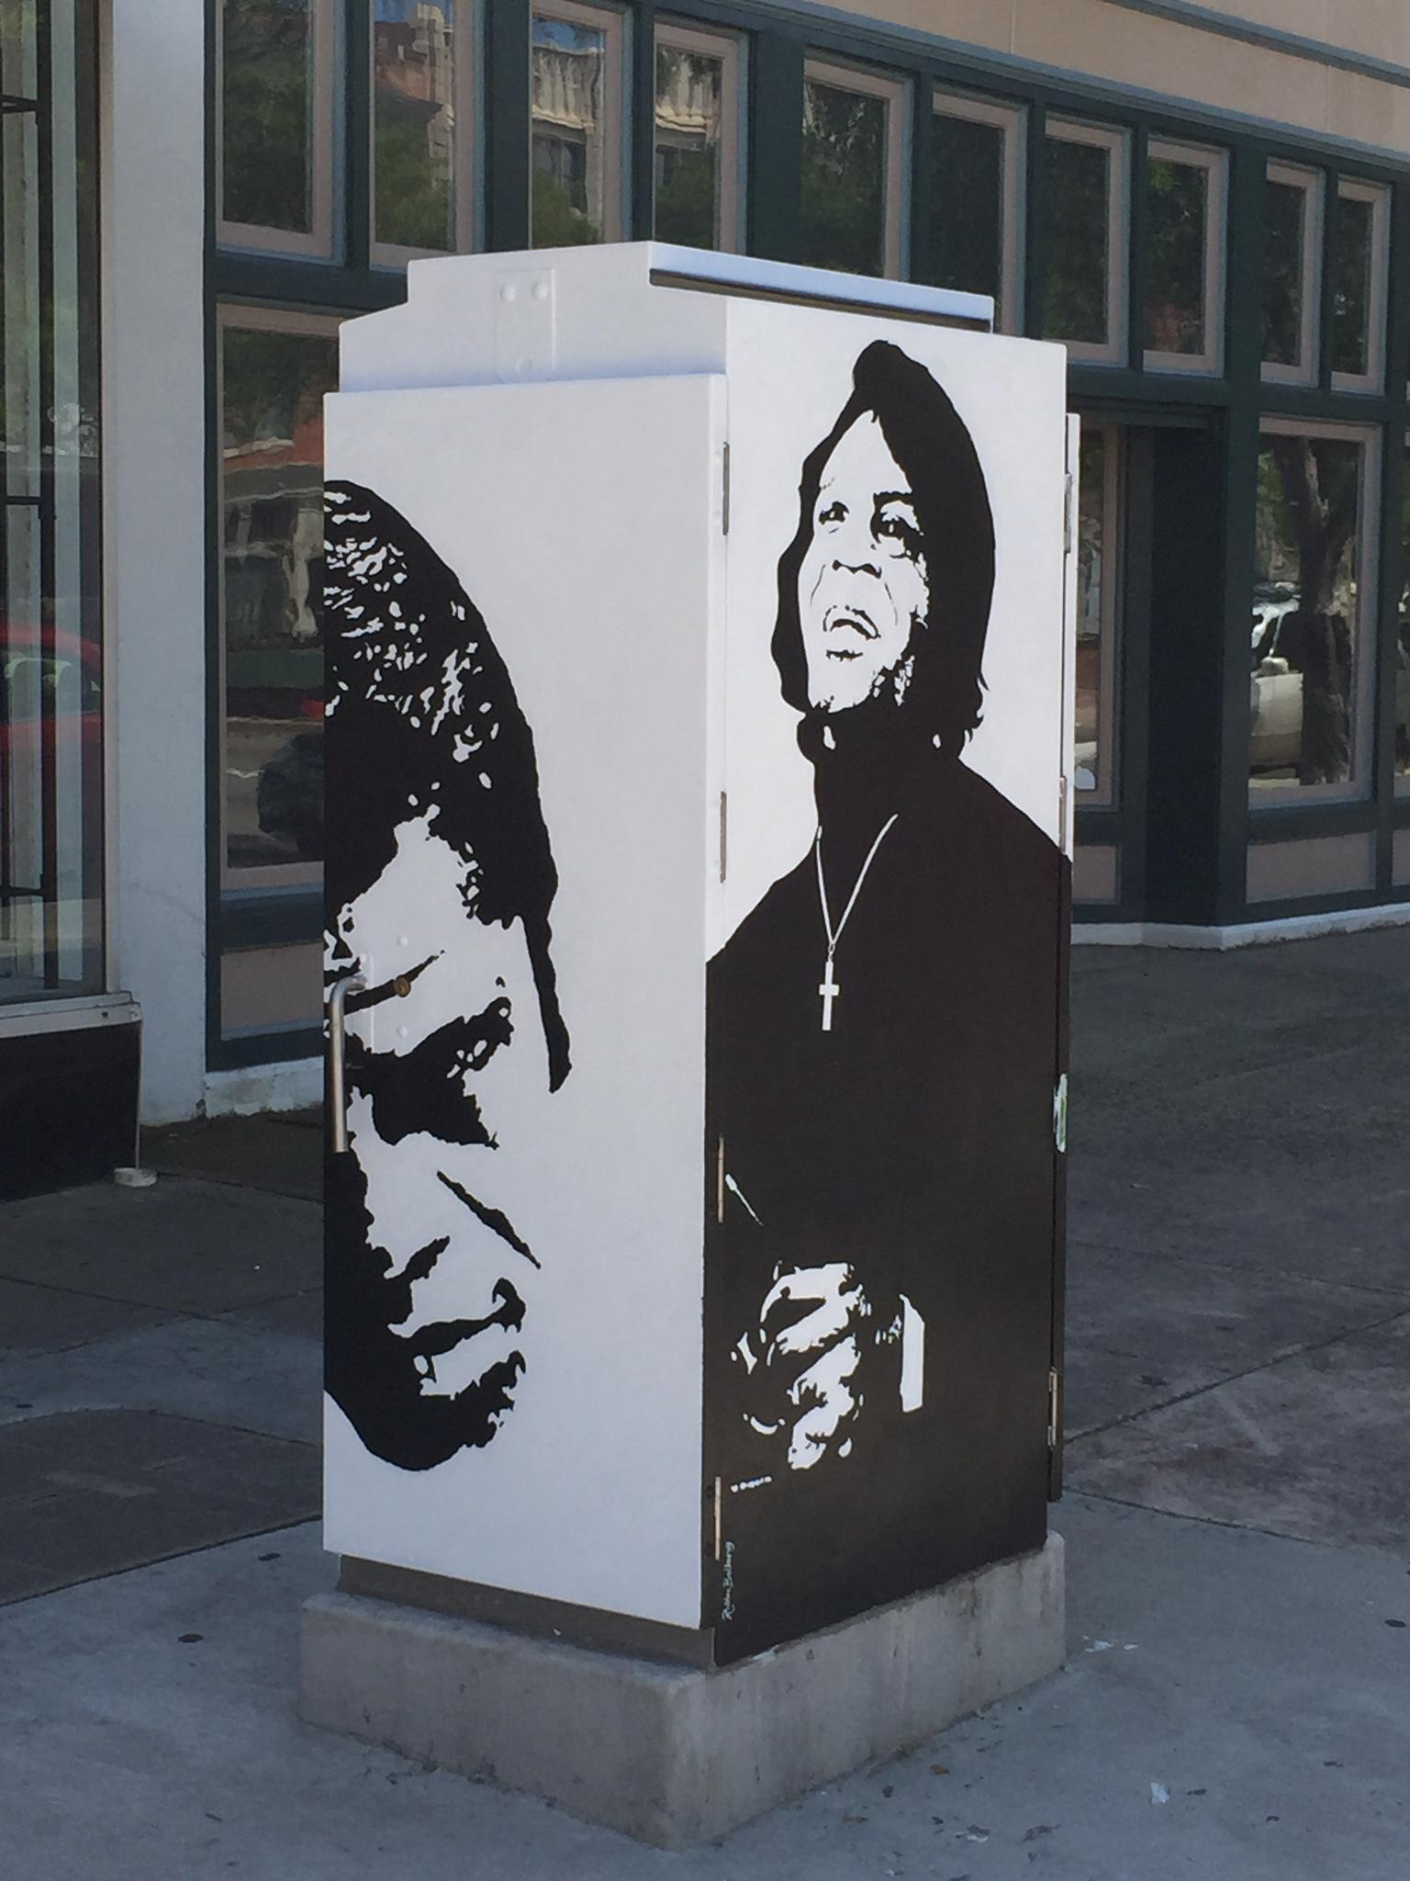
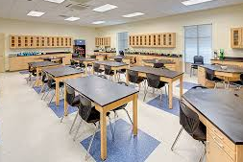
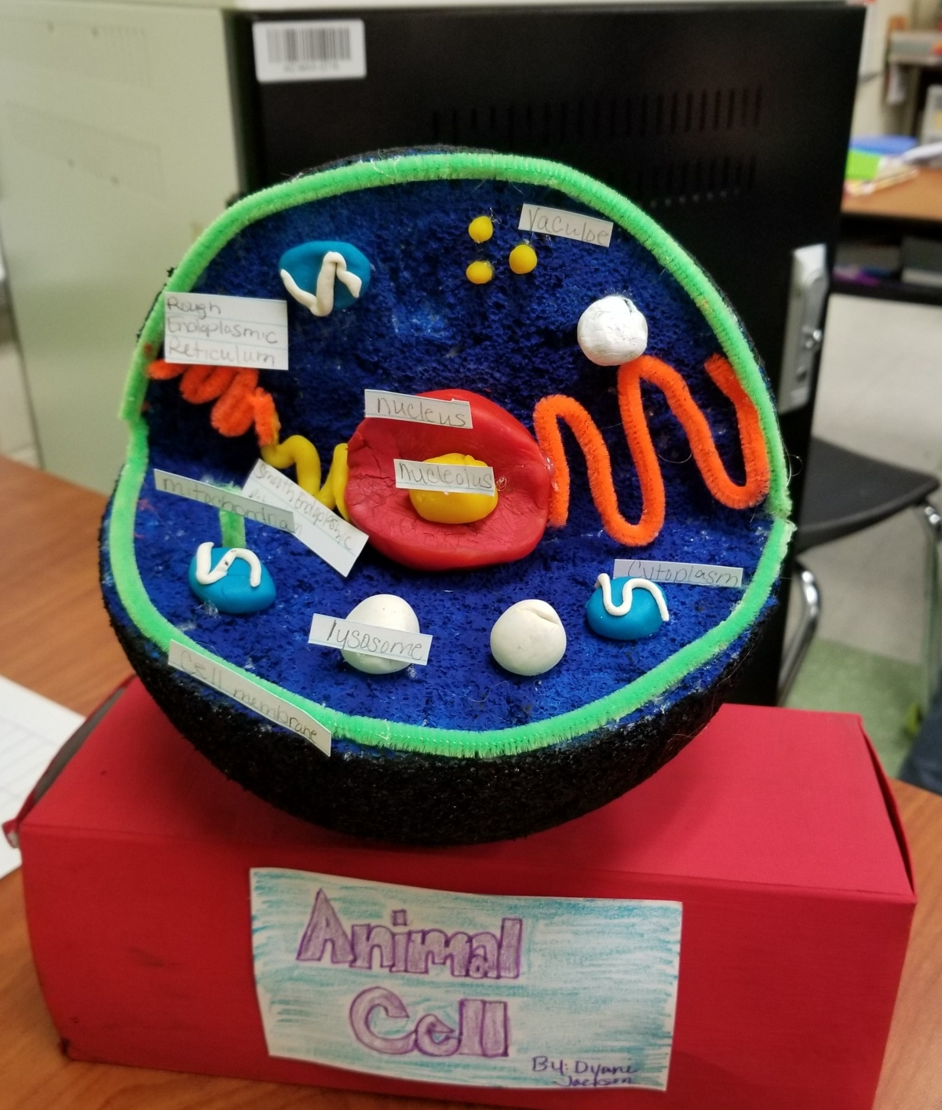
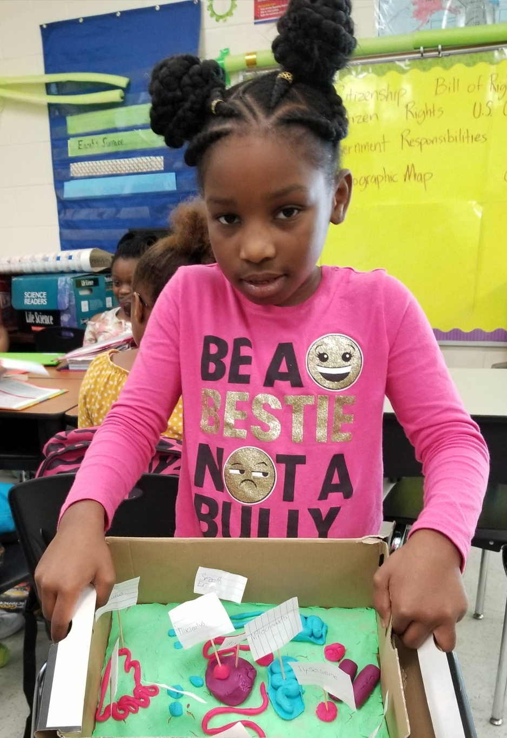
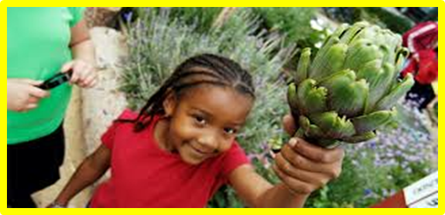
Meet Mr. Scott
The Paw will take you to
the next Slide
Welcome to Augusta’s #1 Middle High School
I am honored that you will be in my class this year. Teaching science for over seventeen years in Richmond County, I look forward to helping you learn about various scientific topics through experiments, inquiries and other hands-on activities that will lead us into technology of the future. My class focuses on creating and designing solutions to scientific question and problems while looking through the microscope of natural phenomenon. We are especially fired up about our new STREAM Interactive Outdoor Classrooms
Thanks for your continuous support!
Support Our School
Tour Our School
Tour Our ClasSroom
My Schedule
Science*Technology*Reading*Engineering*Agriculture*Art *Math
Bitmoji STREAM Classroom
HOME:
MAIN PAGE

Slide 3
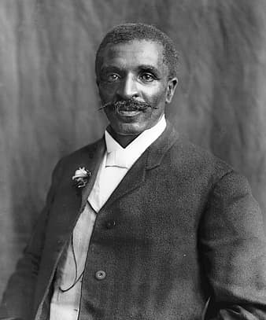
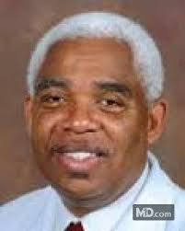
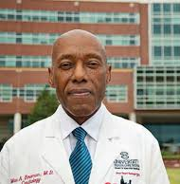
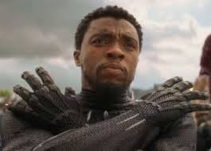
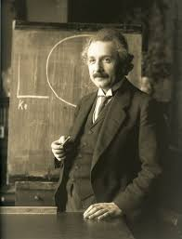
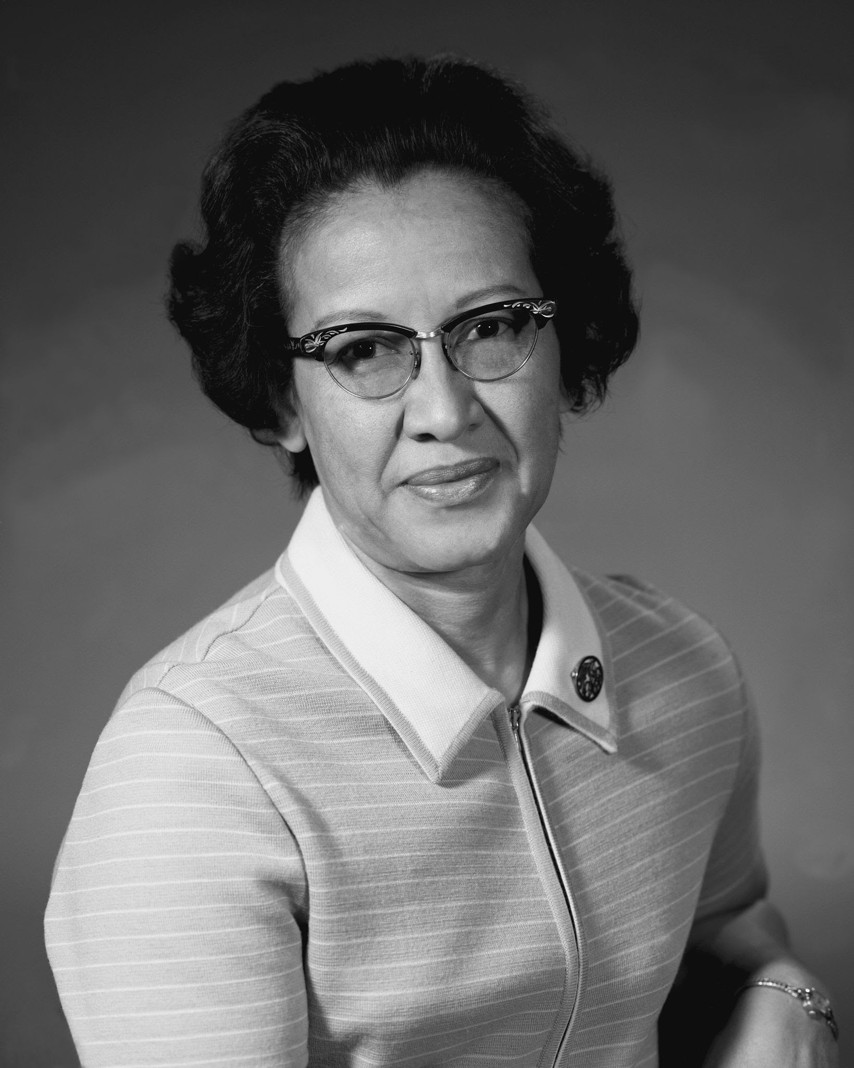
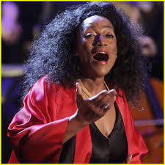
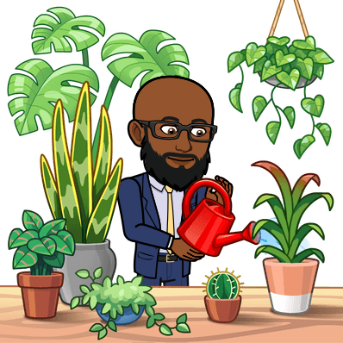
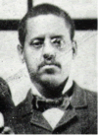
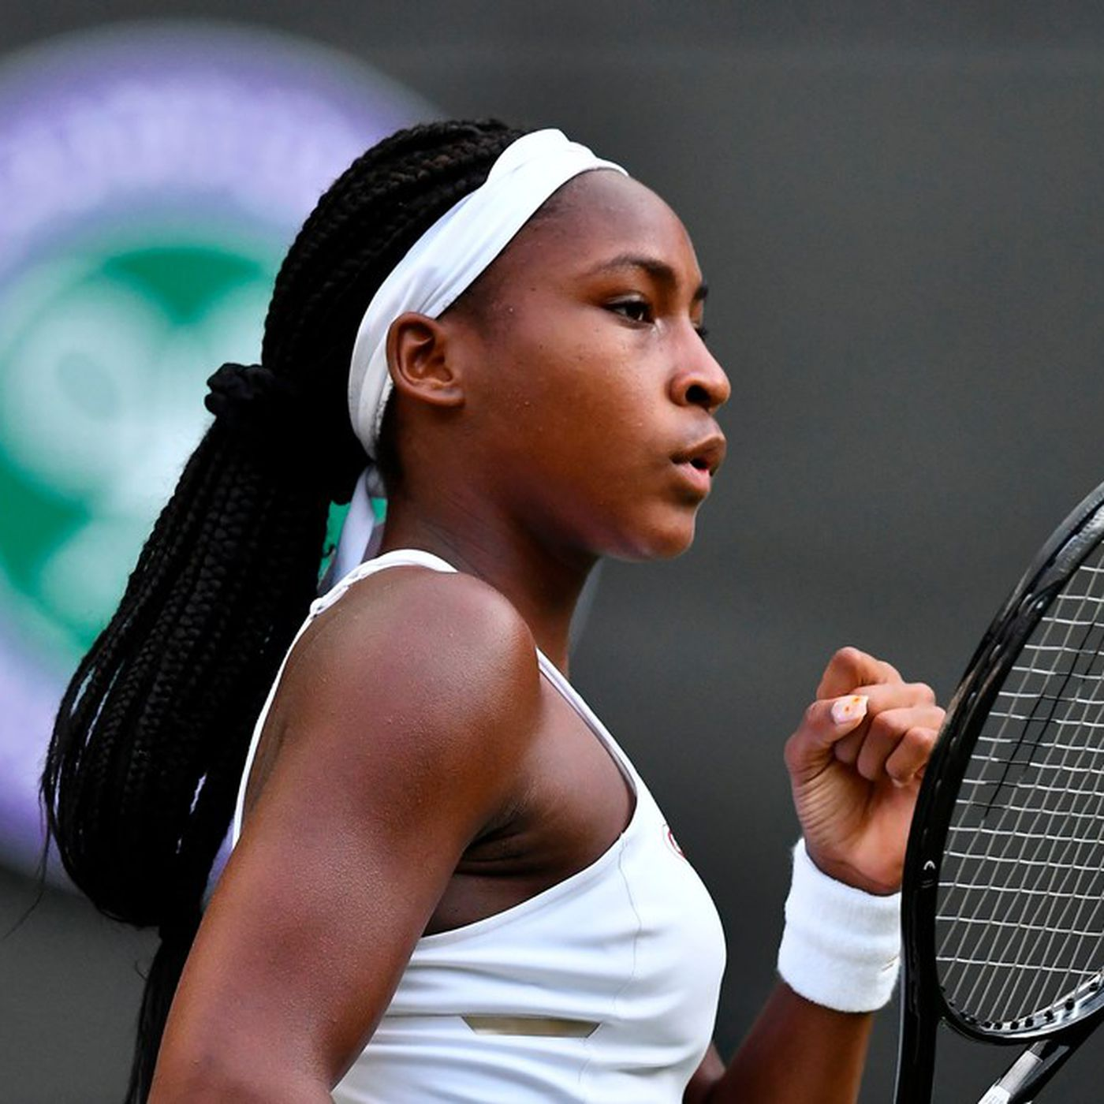
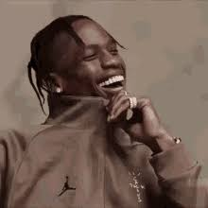
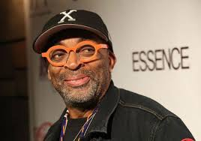
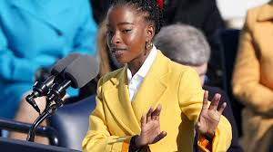
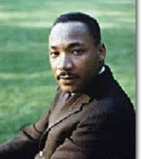
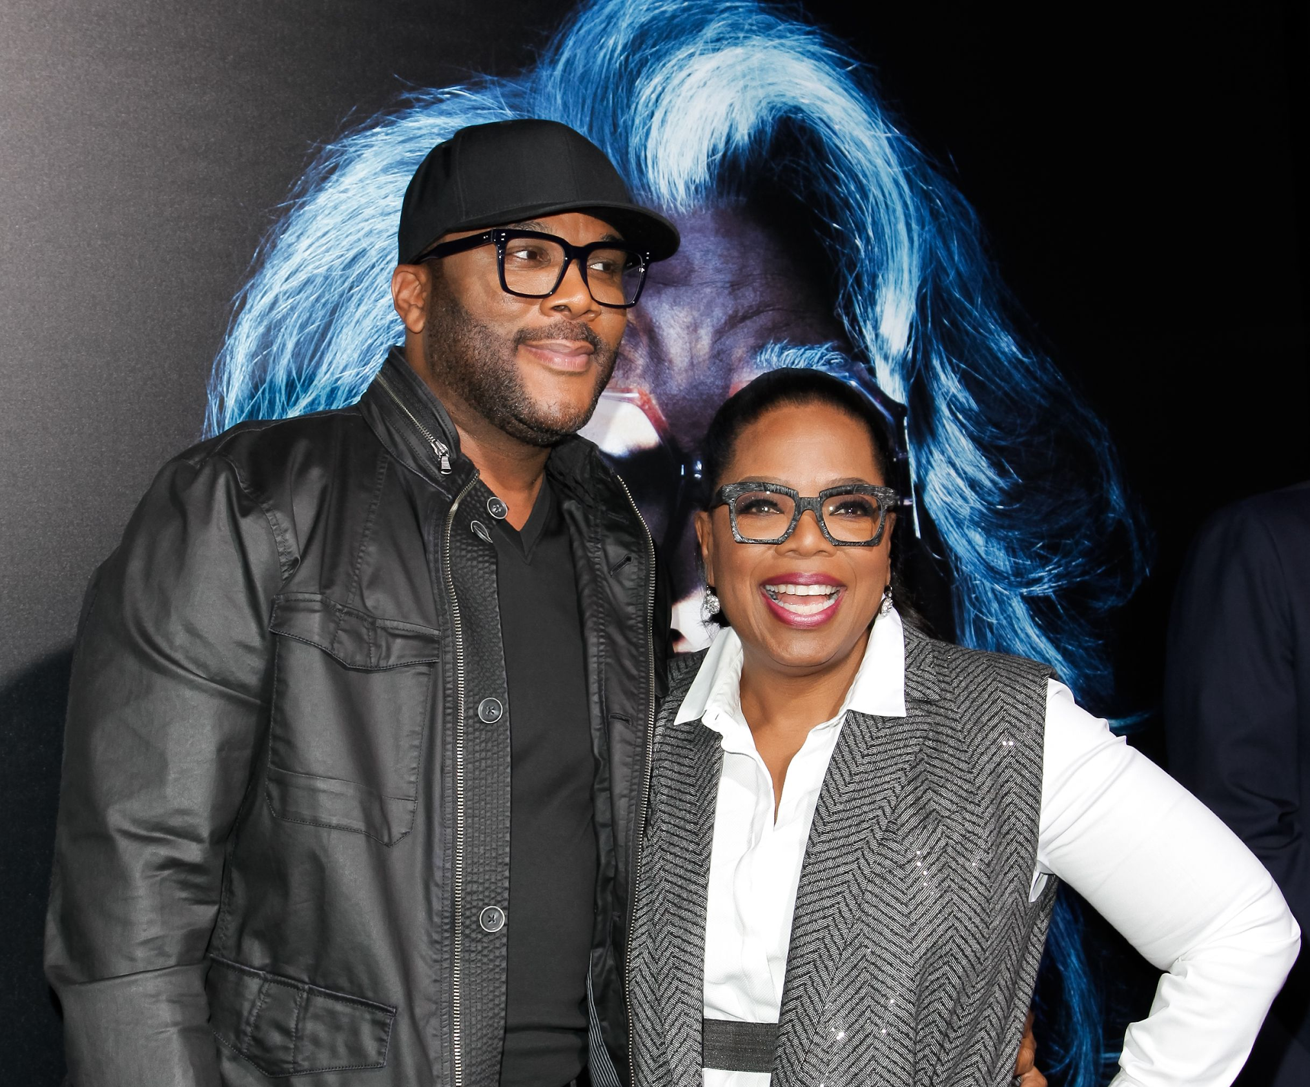
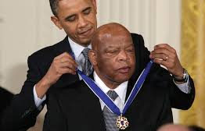
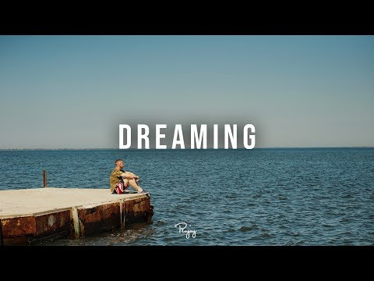
S.T.R.E.A.M
We're Empowering Today's Students to be Tomorrow's Leaders
STRIVING TO REACH EXCELLENCE IN EVERY ASPECT OF MODERN EDUCATION
DISCOVER CREATE EXPERIMENT ANALYZE IMAGINE
SCIENCE
BE THE DREAM
LEADERS in EDUCATION & INNOVATION
TECHNOLOGY
READING
ENGINEERING
ART/ AGRICULTURE
Welcome to our new STREAM The DREAM
INTERACTIVE OUTDOOR LEARNING CENTER
MATH

Slide 4
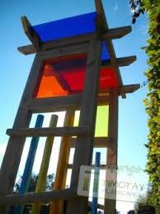
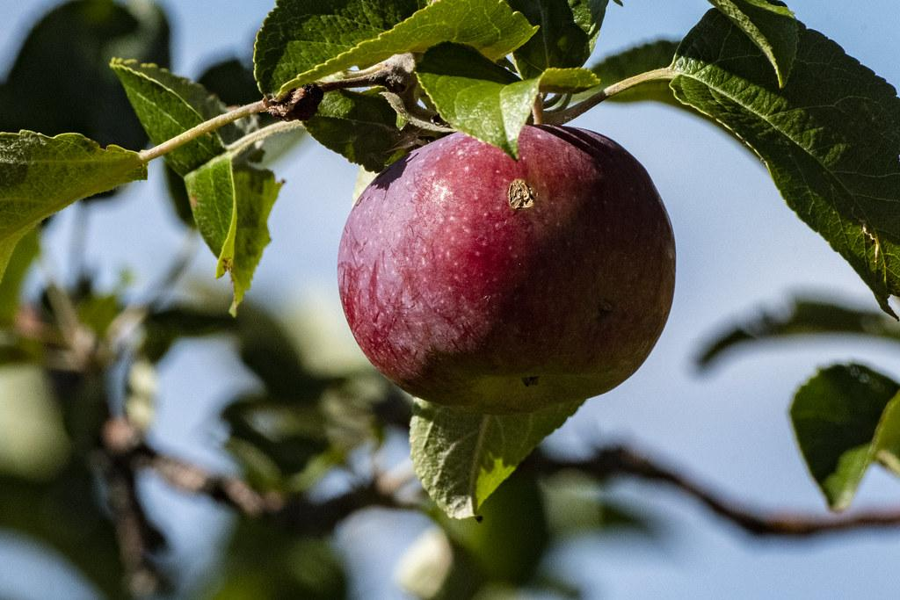
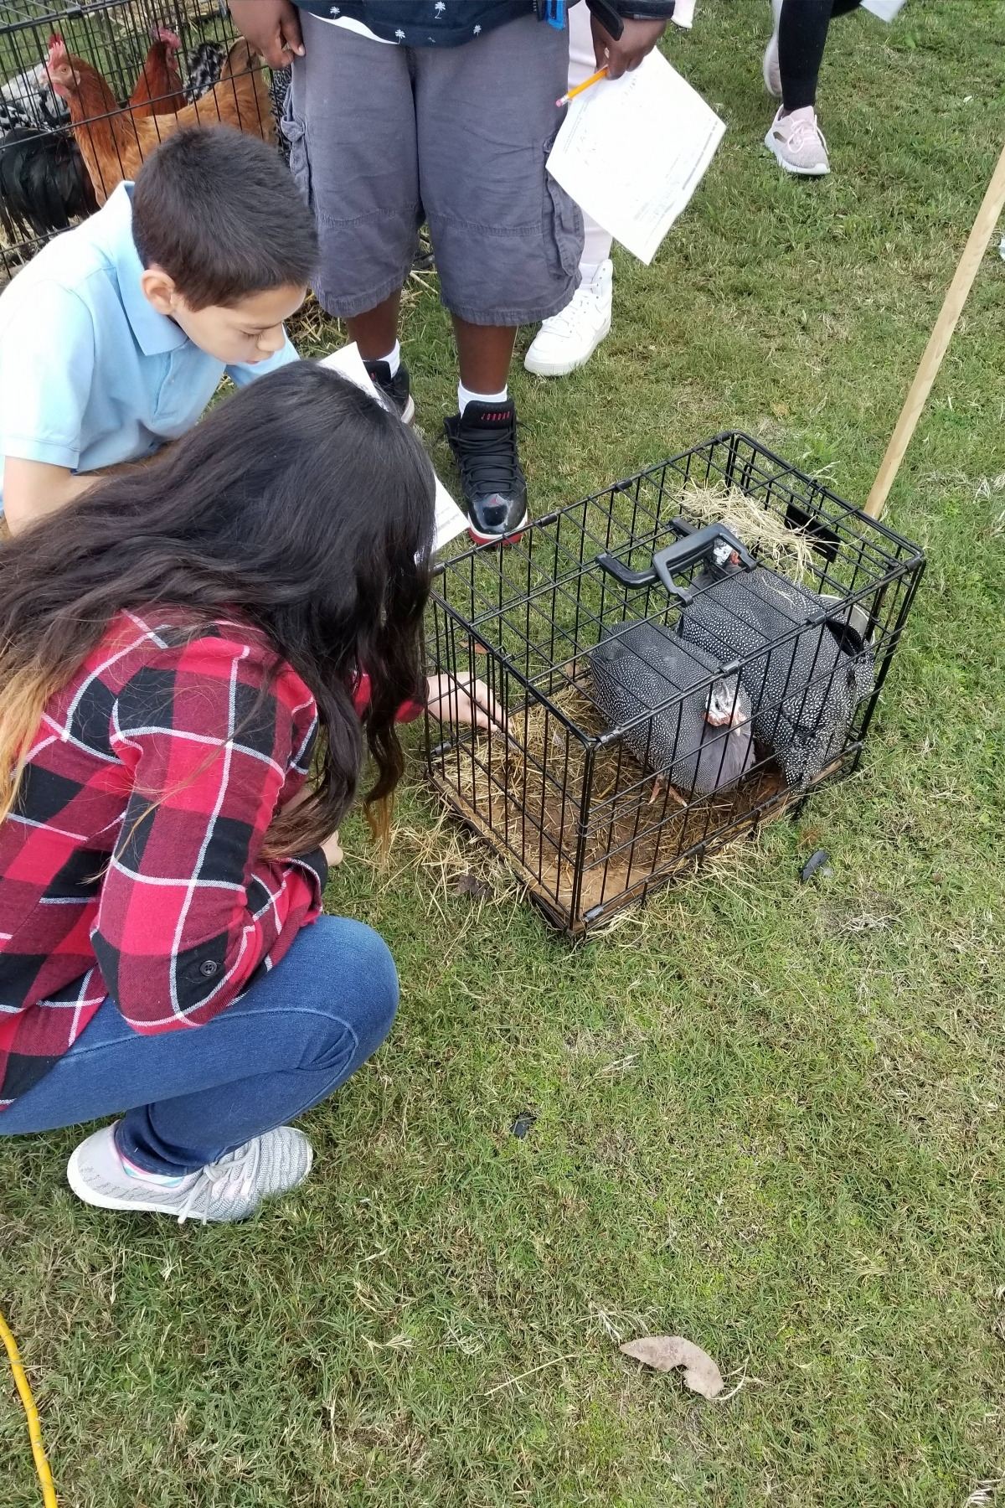
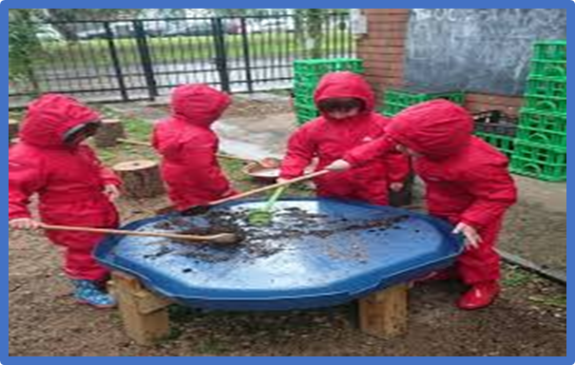
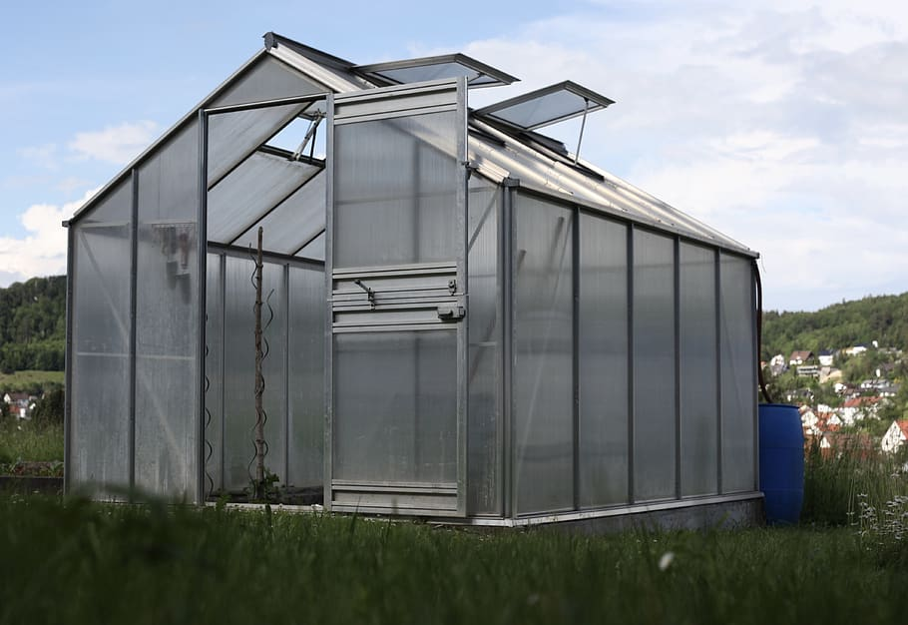
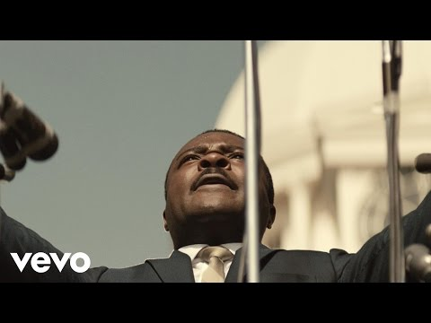
Features
* Greenhouses
* Sensory Gardens
* Soil Testing Center
* Solar Science LAB
* Hydroponic Towers
* Reading Centers
* Aquaponic Systems
* Animal and Biome Investigation Center
Education Outside The Box
The DREAM Center
* Community Gardens
* Weather Station
* Constructed Play Areas
* Light and Sound Center
Reading Center
Sustainable Produce
Community Garden
Light and Sound Center
Greenhouses
Animal Investigation
Hydroponic Towers
BE THE DREAM
LEADERS OF EDUCATION AND INNOVATION
We need your SUPPORT.
Be a SPONSOR
Soil Testing
DISCOVER CREATE EXPERIMENT ANALYZE IMAGINE
We must use time creatively, and forever realize that the
time is always ripe to do right - Dr.Martin Luther King Jr.
Hains
Elementary
Presents
The
DREAM
Center
Our New Interactive STREAM
OUTDOOR LEARNING CENTER

Slide 5
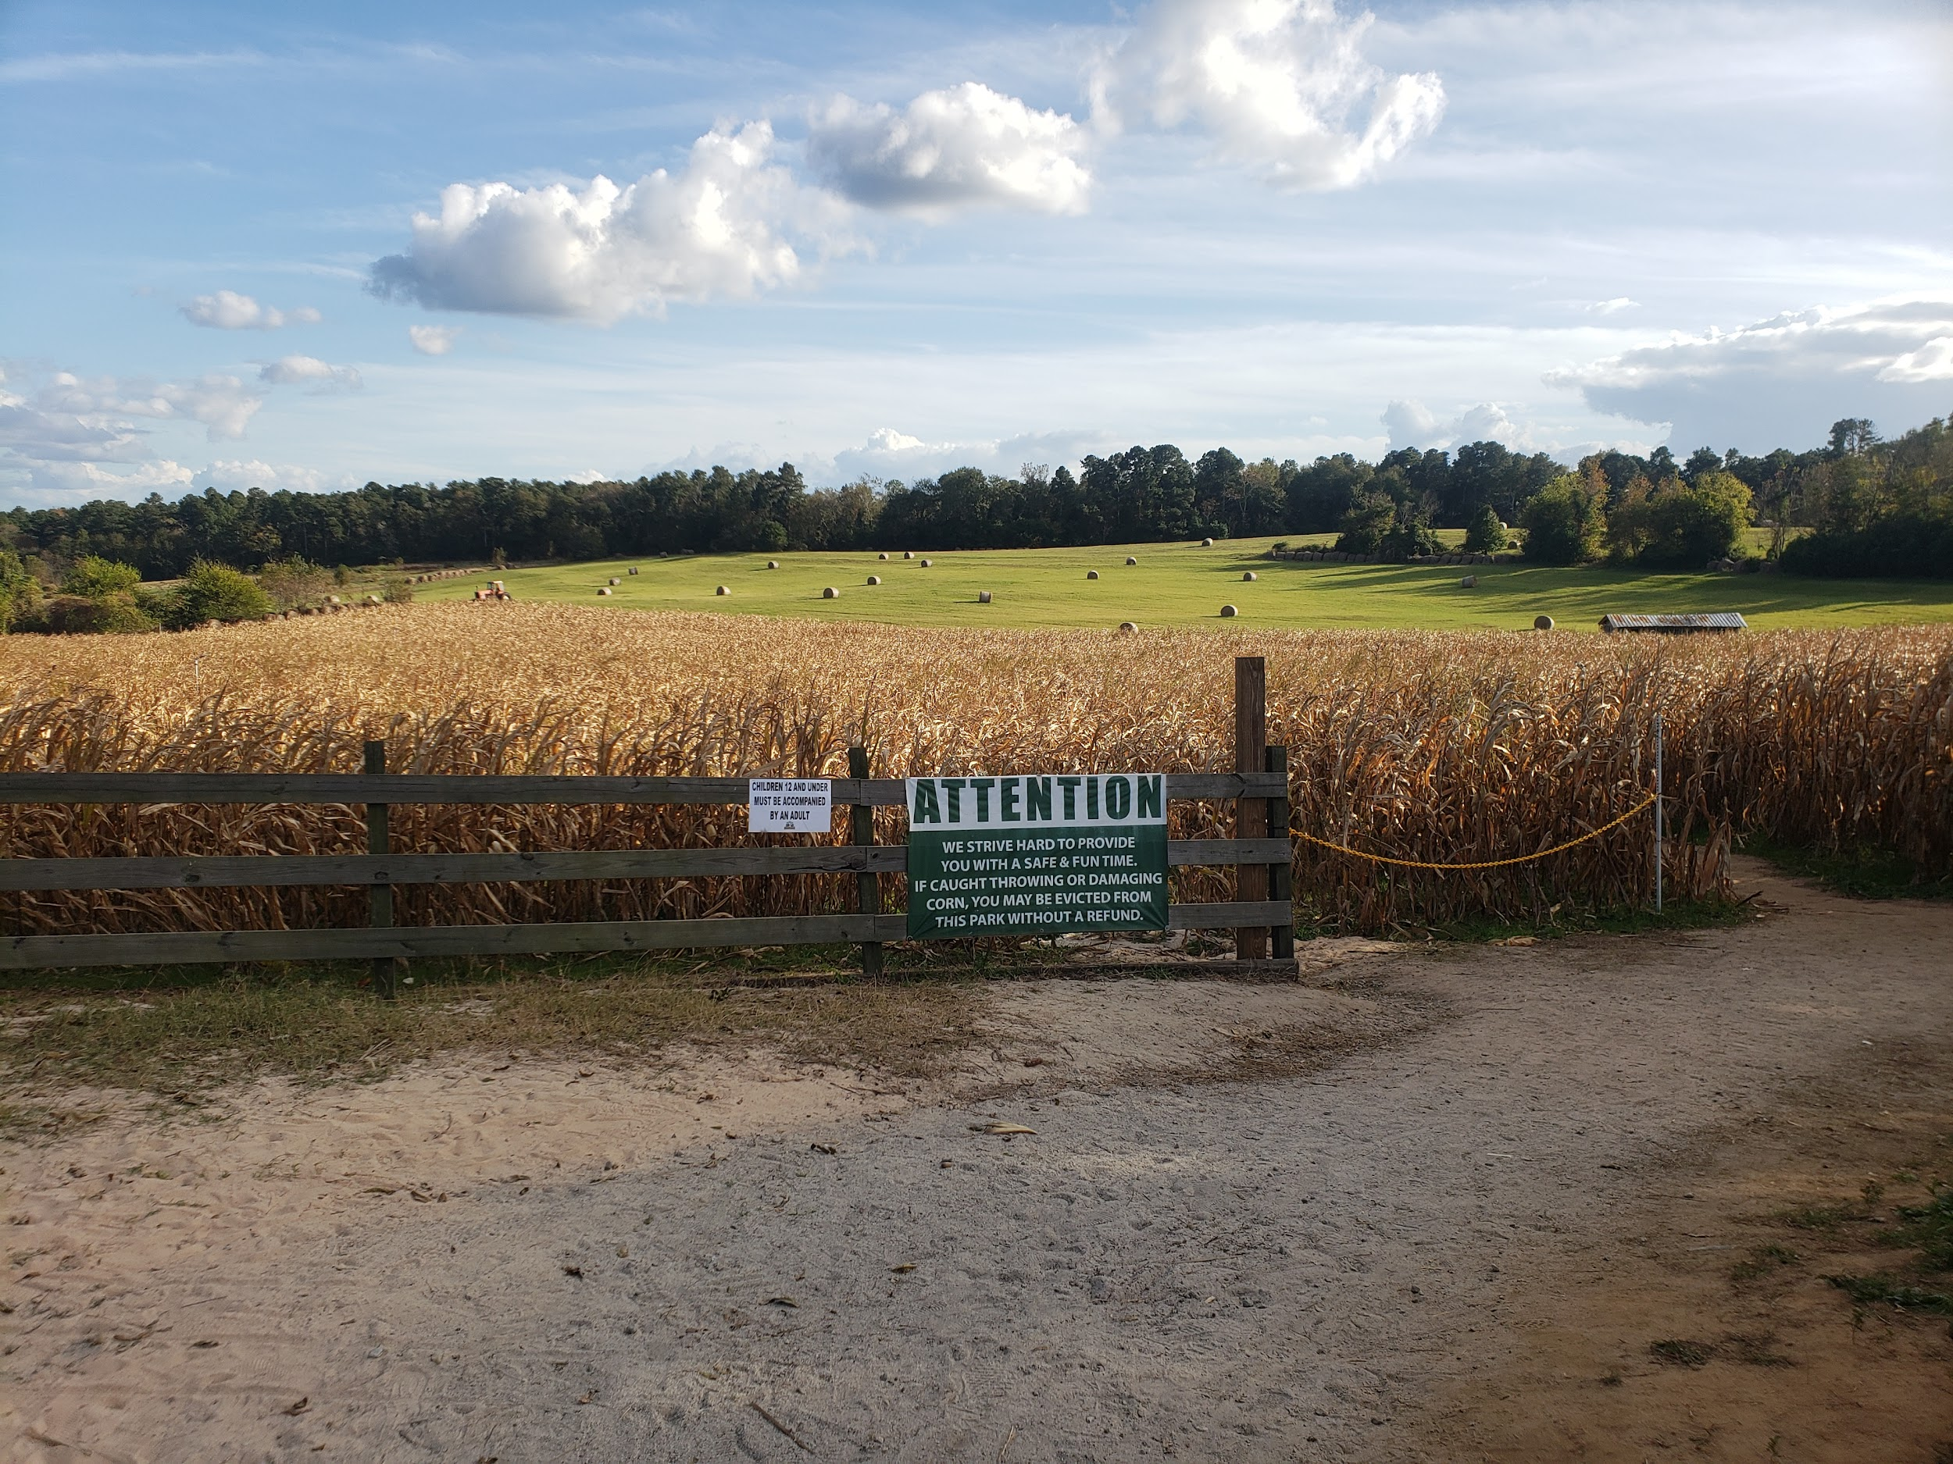
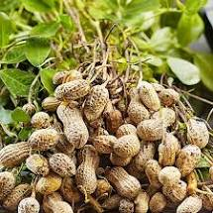
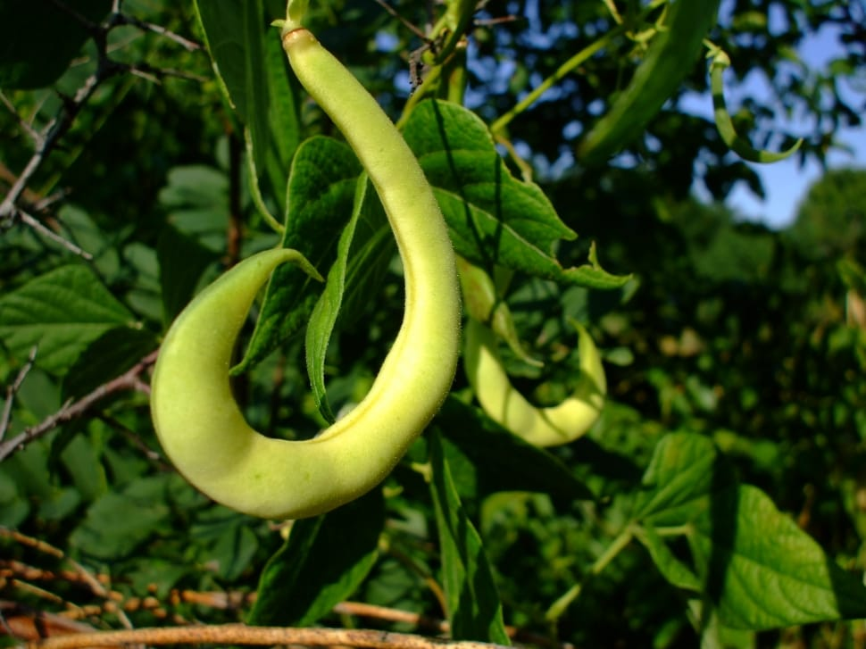
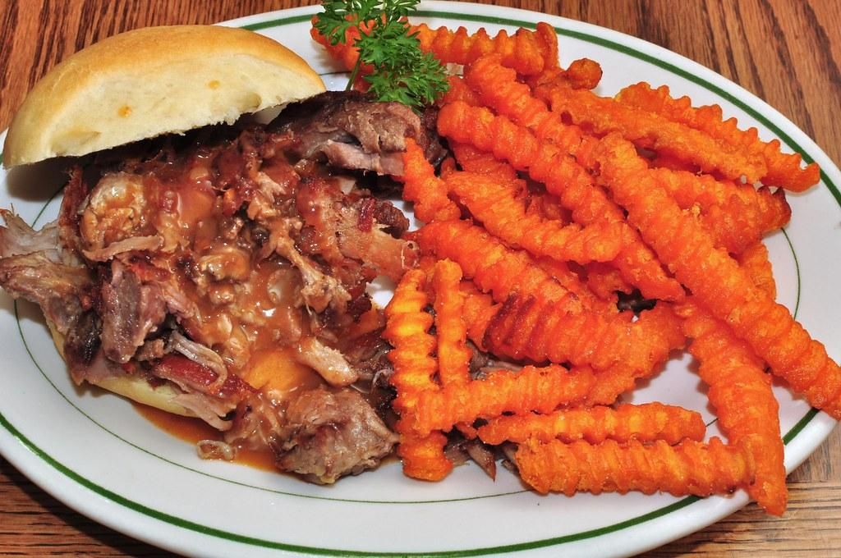
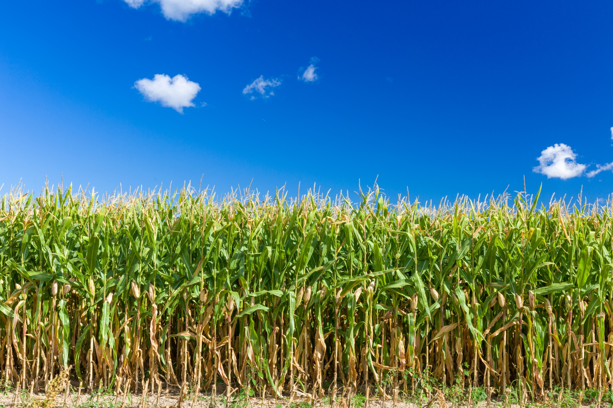
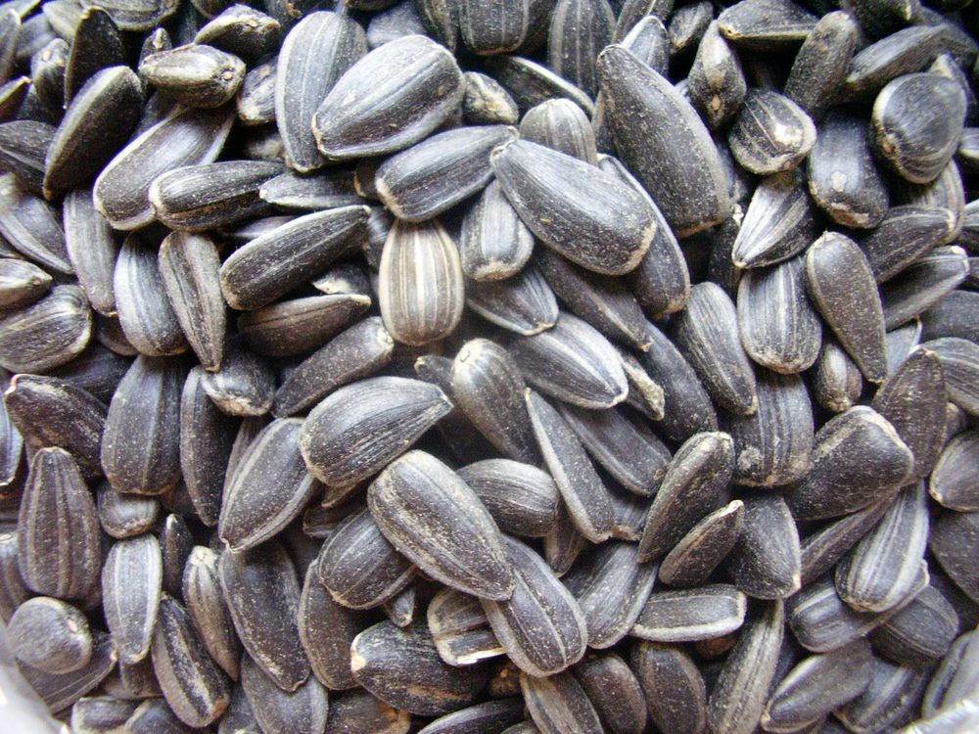
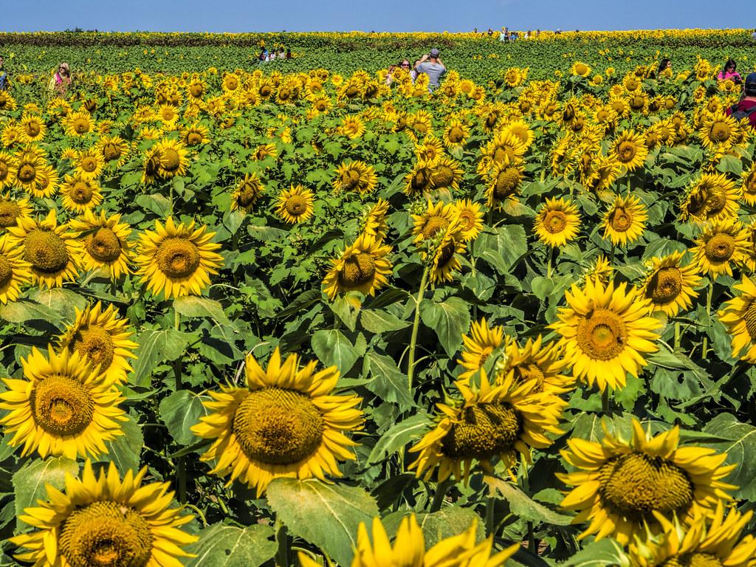
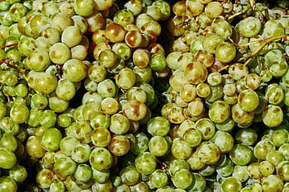
What are we growing?
Life Long Learners
Rise up For education that is above average and outside of the box
Productive Citizens
Producers in Every Aspect of Education
Georgia Natives
Peanuts
Soybeans
Sweet potatoes
Corn
Sunflowers
Muscadines
Education Outside
The Box
BE THE DREAM
LEADERS OF EDUCATION AND INNOVATION
The
DREAM
Center
Our New Interactive STREAM
OUTDOOR LEARNING CENTER

Slide 6
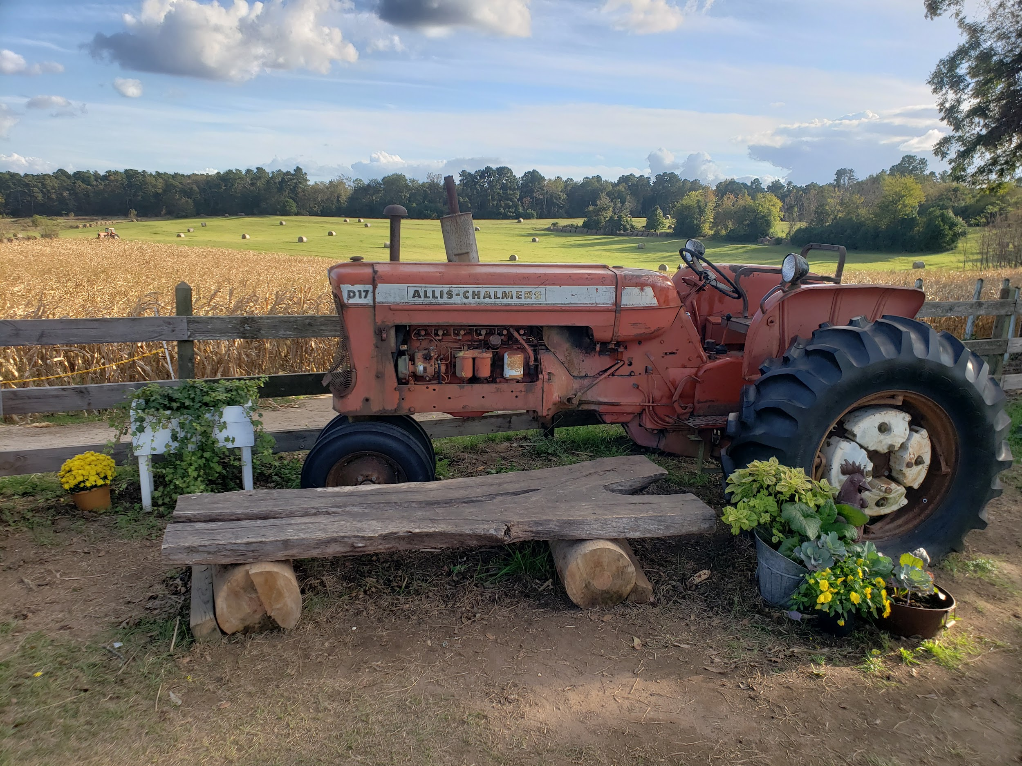
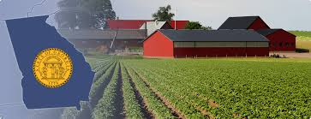
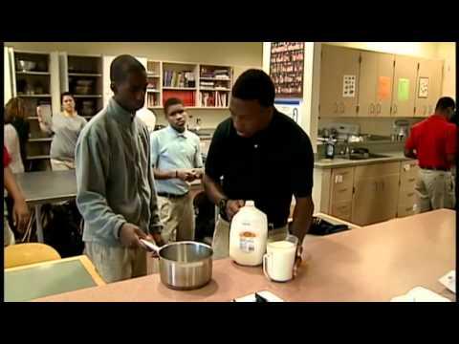
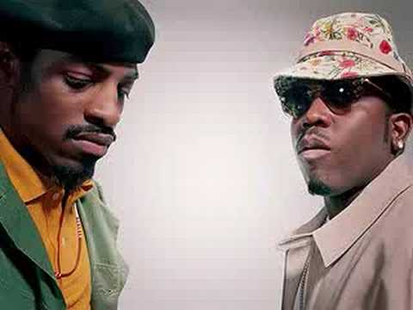
From the Farm to The Classroom
Coming Soon March 30
STEAM SCIENCE
presents
Georgia’s # 1 Industry is still Agriculture
Animal and Plant
Extravaganza
Protecting Georgia’s
Plants and Animals.
Augusta GA “The Garden City of the SouTh”
A. R. Johnson Health science engineering
magnet School
Photography and Music by DJ Scott
STREAM SWAG Productions Inc.

Slide 7
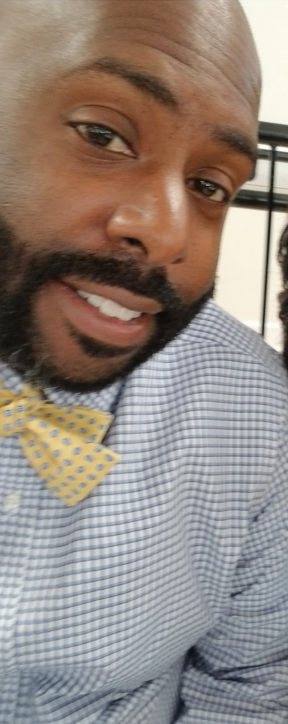
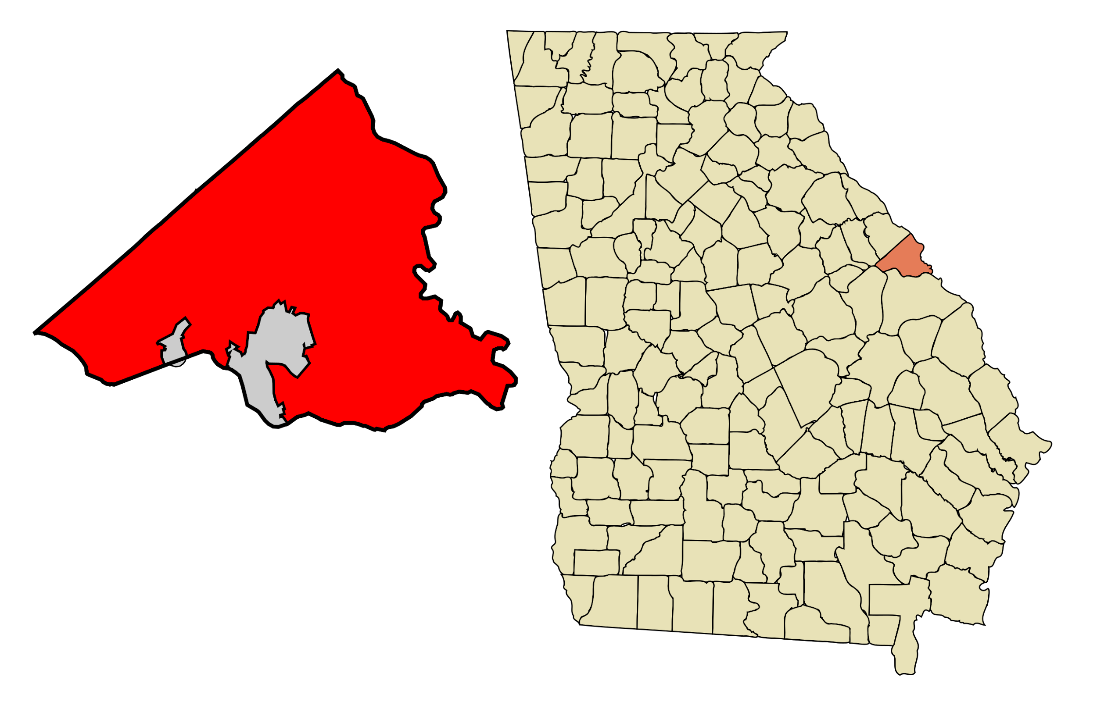
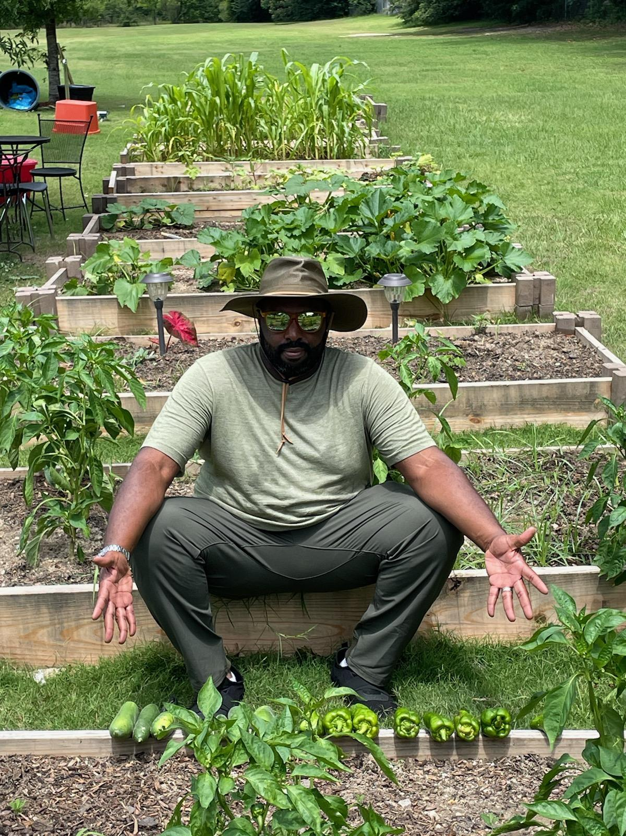
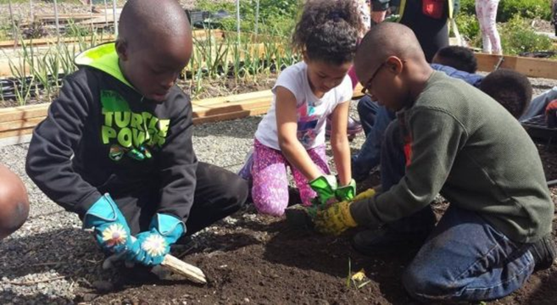
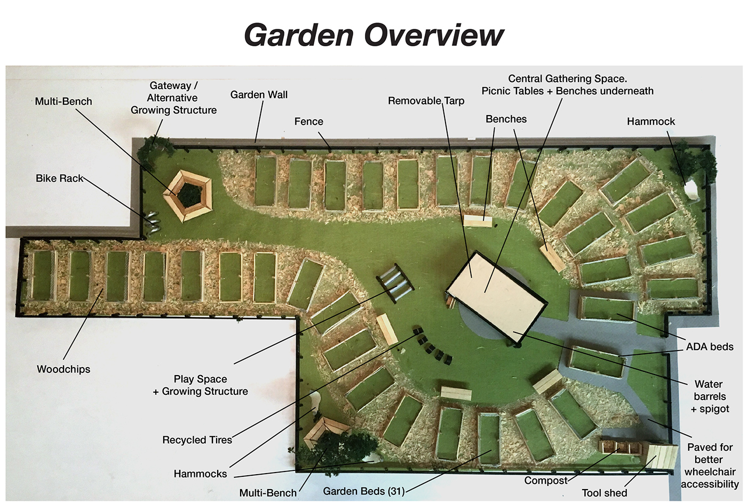
The Journey STREAM Garden
In the “Garden City” Augusta GA
STEM SCIENCE TEACHER
Urban Agriculturist
Ergonomic & Culinary Studies:
The Effects of Socio Economics in Health, Nutrition, and Food Diversity DENARD SCOTT
Pastor Keith Walden
Community Leader
Sherwood Community of South Augusta
Our New Interactive STREAM
OUTDOOR LEARNING CENTER
The DREAM Center

Slide 8
What is Georgia’s number one agricultural crop?
Georgia is considered to be on of the most agriculturally diverse states in the U.S.
Have your students research this!
Find the Answer.
What scientist was famous for finding several ways to use and cultivate peanuts ?
Muscadines

Slide 9
STEM SPRING BLING Week
On March 20, 2021 , the spring (vernal) equinox occurs, marking the astronomical first day of spring in the Northern Hemisphere.
Monday - Neon and Bright Spring Colors
Tuesday - Animal Print (Animals)
Wednesday - Green or Camouflage (Plants)
Thursday - Wear Blue And Gold ( Representing our school and Autism Awareness)
STREAM SPRING FESTIVAL
Animal and Plant Extravaganza

Slide 10
Our Future STREAM Interactive Outdoor Classroom
We Need Your Support!
Be Apart of the DREAM
In order for us to reach every child we must think outside of the parameters that we normally consider a classroom environment. The entire world is our classroom and we should not limit our Dream.

Slide 11
Mr. Scott’s Schedule
Every Day
 | 5th Grade | 4th Grade | 3rd Grade | 2nd Grade | 1st Grade | Kinder
Mon. | 9:45 - 10:30 | Asynchronous Differentiation | 10:30 - 11:15 | 1:30 - 2:15 | 12:30 - 1:20 | 11:50 - 12:30
Tues. |  | 8:00 - 8:40 Specials Programs Collaboration | 10:30 - 11:15 | 1:25 - 2:15 |  | Birch
Wed. |  | Synchronus Differentiation
Thur | Virtual & PL Collaborative | Specials Programs Collaboration | Virtual & PL Collaborative | Virtual & PL Collaborative | Virtual & PL Collaborative | Virtual & PL Collaborative
Fri. | 8:45 - 9:35 | 8:00 - 8:40 | Agriculture / Art Curriculumn Dev.
It is essential that we introduce and constantly expose our students to various avenues of higher education in order to gain and cultivate skills which empower them to be courageous, uncommon, and competitive in a global market. We must make a collaborative effort to construct, a systematic schedule for success. Don’t wait until high school. The future is now. Make you schedule today!

Slide 12
Laboratory Safety
HOME:
MAIN
PAGE
SUPPORT OUR SCHOOL
Safe: Mindset
Safe: Emergency Procedures
Recognize Hazards R.A.M.P
Laboratory TOOLS
Cool Experiments with Water

Slide 13
Mr. Scott's Meteorologists - Biochemical Engineers
Meet the
first black
meteorologist
Tushegee Airman
HOME:
Unit 1: Weather Today’s Weather
Unit 2: Needs of Living Things
Unit 3: Light and Sound
Unit 4: Magnetism
STANDARD
Support Our School

Slide 14
IT
Mr. Scotts Geologist - Mechanical Engineers
https://www.youtube.com/watch?v=D9I35Rqo04E
HOME: MAIN
PAGE
Support Our School
Unit 1: Computer Programming
Unit 2: Design & Media Production
Unit 3: Coding
Unit 4: System Analyzing
Standards

Slide 15
Employability Skills
TOOLKIT
Career Technical and Agricultural Education
Employability

Slide 17
Employability
CHARACTER
COMMUNICATION
CRITICAL THINKING
INITIATIVE & INTERPRISPRISE
PROFESSIONALISM
TEAMWORK

